Slide 1
VisionPLUS Overview
Loyalty Management Service (LMS)

Slide 2
Agenda
What is LMS?
LMS Features
LMS system Architecture
LMS Control Records
LMS concepts – Scheme, Plan, Group
Enrollment
Account status
Points calculation
Accounts maintenance
Point Adjustments
Redemption Process
General Ledger

Slide 3
What is LMS ?
LMS (Loyalty Management System) is a system designed to allow card issuers to build a base of loyal customers by rewarding them with points or cash-back rebates according to their use of the card.
This is a new VisionPLUS subsystem which presents a consistent look and feel as other VisionPLUS modules to maintain ease of use for operators and end-users.
It is parameterized and enhanced (over CMS Frequent Shopper functionality) to provide maximum flexibility and tailoring from one loyalty scheme to another.
It is integrated with other VisionPLUS subsystems to provide customers and users end-to-end Reward Programs experience.
It also provides basic features to manage customer points redemption and fulfillment.
It provides ability to partner with merchants and stores for managing promotions and redemptions.
It provides different options to setup additional promotions based on several criteria to provide customized reward programs.

Slide 4
LMS Features
Feature | LMS Offering
Origination | Ability to board customer in LMS at the time of CMS account boarding. Ability to board customer in LMS at any point later than CMS account boarding.
Reward Programs | Ability to run multiple rewards programs per customer at any given point.
Merchant Affiliation | Ability to setup promotional programs in affiliation with Merchants.
Points Calculation | Ability to setup different points earning rate based on different type of transactions Ability to setup different points earning rate for international transactions.
Additional Promotions | Ability to setup additional promotions based on following criteria SKU Store CMS Logo Credit Plan State Day Of Week BIN Merchant Name MCC Code

Slide 5
LMS Features (Contd.)
Feature | LMS Offering
Behavior Based Points | Ability to setup additional promotions based on Starting Points (Enrollment Points) First Usage Account Anniversary Customer Birthday Account Boarding Channel Redemption Channel
Account Segmentation | Ability to segment accounts in different groups and manage their rewards differently
Points Tiering | Ability to setup different points earning rate based on customer spend in a given period of time
Points Capping | Ability to setup Points Cap for a given period of time.
Automatic Disbursement | Ability to setup disbursement (redemption) of points automatically based on A pre-defined amount of points A pre-defined period (e.g. every quarter, every year etc.)
Redemption | Ability to redeem points and define reward items for redemption
Points Adjustment | Ability to adjust points manually for customers
Points Expiry | Ability to setup expiry of unused points

Slide 6
LMS Features (Contd.)
Feature | LMS Offering
Rewards Membership Fee | Ability to assess membership fee for enrolling into reward programs
Statement Interface | Ability to statement accounts along with CMS and insert points summary in customer statement
General Ledger | Ability to setup General Ledgers for points provisioning
Settlement | Ability to generate Settlement extracts for funding parties involved in promotions
Reporting | Multiple reports generated for points reconciliation, system activity etc.

Slide 7
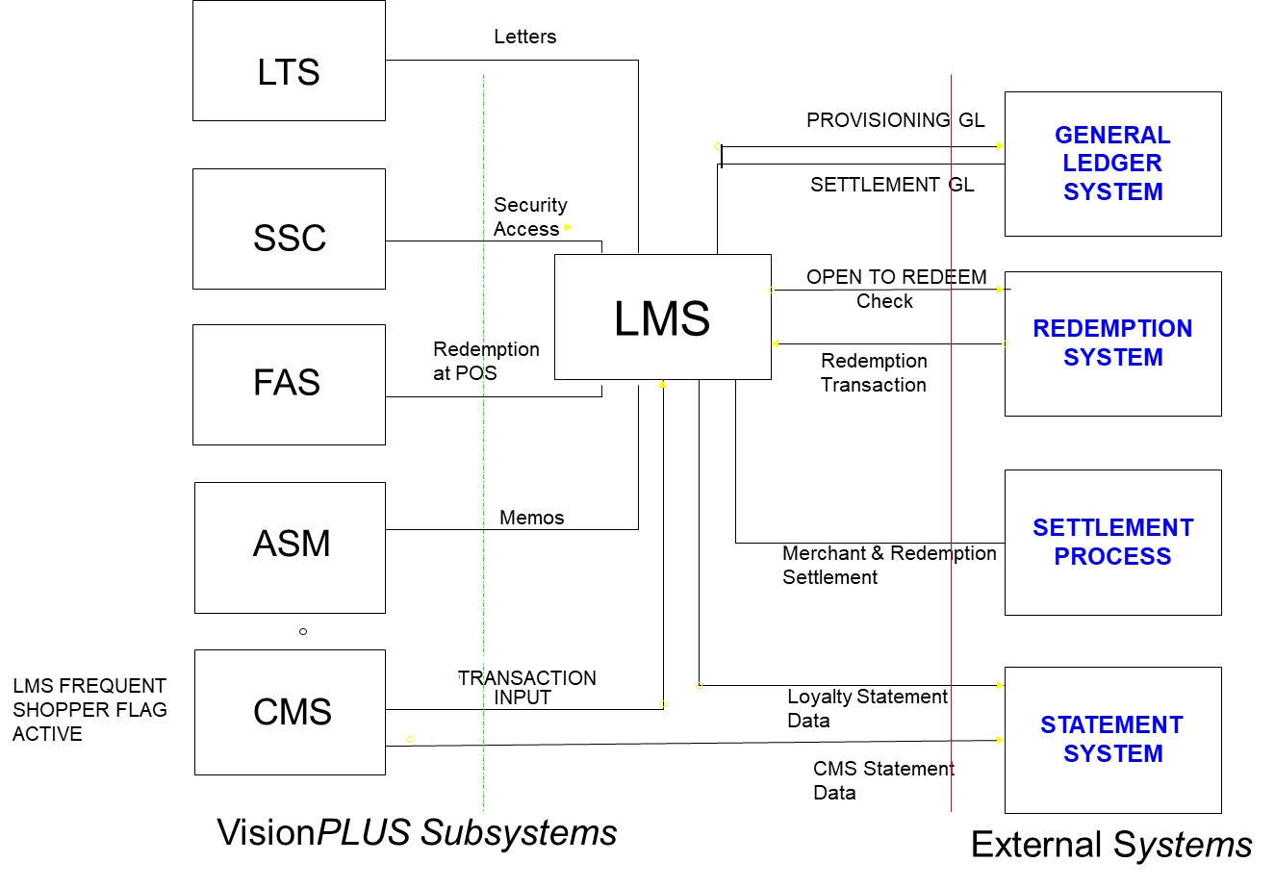
LMS System Architecture
Notes:
Interfaces
Accepts incoming monetary transactions from CMS(AR System)
Accepts incoming non-monetary user input to add and maintain master file data in LMS
Accept incoming non-monetary transactions files from a third party source to allow event based processing
Accepts incoming points transactions for Loyalty accounts from a Third party redemption system.
Creates outgoing General Ledger transactions
Creates outgoing Settlement file
Creates outgoing file of points that have been redeemed
Creates outgoing file of information to support the production of customer reward statements by CMS / Statement system
Provides a real time interface/Services to a third party redemption system

Slide 8
LMS Control Records
System
System
Set LMS Active ‘Y”
Org 100
Org 101
Org 500
Set LMS Active ‘Y”
Org
Org
Scheme 1
Scheme 2
Logo 501
Set LMS Active ‘Y”
Schemes
Logo
Cross Reference
LMS
CMS

Slide 9
Scheme and Group
The Loyalty Scheme represents the reward program - It defines the basic parameter regarding the earning, redemption, membership fee and expiry of points.
Scheme types – Points, Miles, Cashback
Loyalty Scheme allows greater flexibility when setting up scheme (as it is five alphanumeric field).
Group represents the participating entity in the reward program – Issuer, Merchant or group of stores.
Default group : It usually represents Issuer.
All ‘A’s(AAAAA) is defined for each Scheme.
Every store is linked to Default Group (as a minimum) to generate Basic earned points.
It controls the basic earned points awarded to an account and settlement with the Provision Account
Bonus Groups : Multiple Stores participating in a Bonus Rewards Scheme represent Bonus group. Bonus groups can be setup by issuers as well.
Bonus points are awarded for Bonus group.
A Store can be associated with multiple Groups

Slide 10
Points Plan
Points Plan is a promotional offer within a rewards scheme.
Points as are accrued as per the points plan set up. Points Plan is linked to Group(s) – both default & Bonus.
Every rewards scheme has to have at least one active plan to award the points.
LMS defines following types of points plans for each Group attached to a Scheme:
Base points that are allocated to a loyalty account as part of the standard features and
offerings of the loyalty program – Base Plan
Supplementary points that are offered in addition to the base points for a specific
promotion/period – Supplementary Plan
Override points that are offered instead of the base and supplementary points –Override Plan
Plan e.g. an offer of double points for the month of December for every dollar spent
Extra Points Plan allows accrual of points on-cycle based on the total transaction spend amount per cycle. Plan Control Record

Slide 11
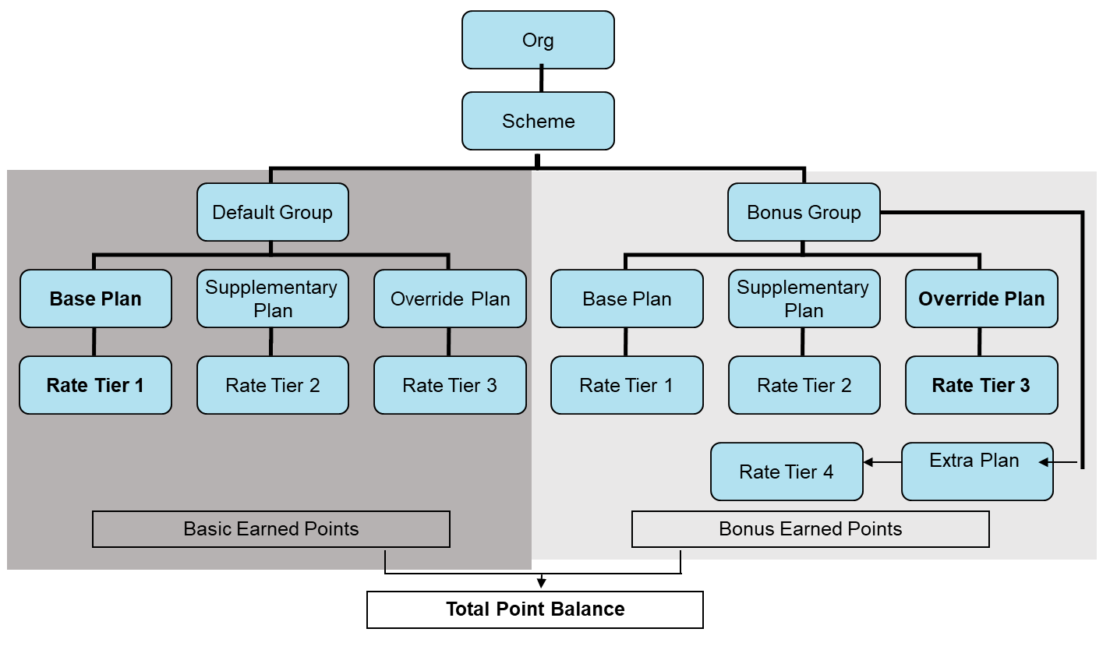
Scheme, Group, Plan - Structure

Slide 12
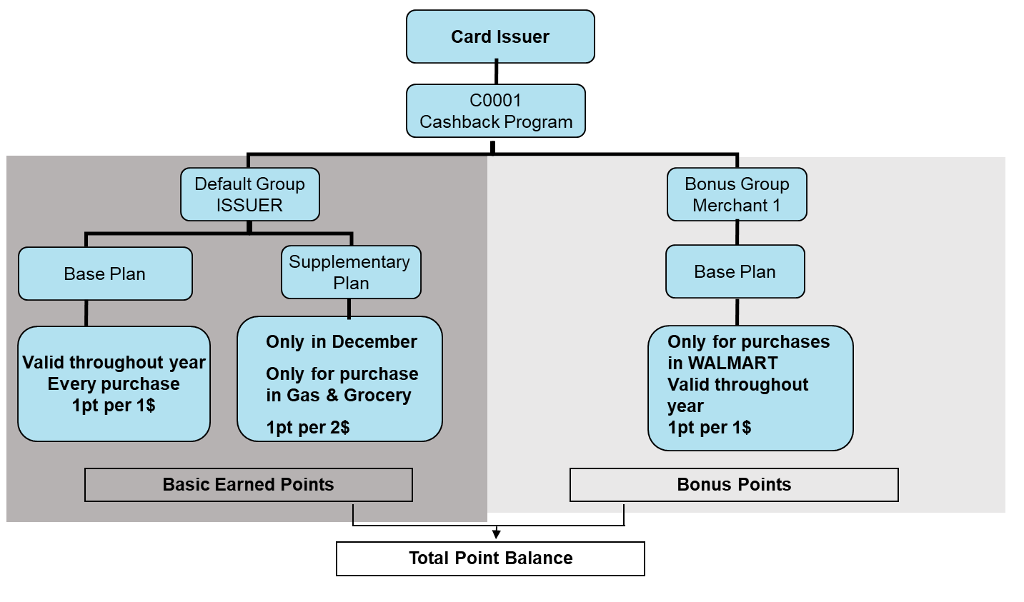
Example – Scheme-Plan Setup

Slide 13
Enrollment
Enrollment Feed
Scheme Selection
Create LMS Account
CMS
LMS Native Online screens
Web Front End*
Logo-Scheme Cross Reference
Link
Points Account (LMS account number) LINK
LMS Demographic
CMS-LMS account cross number - LINK
Customers can be enrolled into multiple schemes
Points balances per Scheme are maintained at ‘Points Account’ Level
Example: Cross reference - Logo 100 – Scheme ‘FRED’ – Cahsback
CMS Account-0004072209000001547 – Logo 100 – Gets enrolled into ‘FRED’ – LMS account number - 0000000000000000020
Screen

Slide 14
LMS Account Status
During System Set up
During Account Processing
LMS System Control
LMS Status
Status | Earn | Redeem
Active | Y | Y
On Hold | Y | N
Frozen | N | Y
Pending Close | N | N
Close | N | N
Check CMS Account for:
Delinquency
Block Code
Overlimit
Apply LMS status code on LMS account
During Transaction Processing
LMS Status Impact
Check LMS account status
Verify System Control Parameters
Allow or deny Earn / Redemption request
14

Slide 15
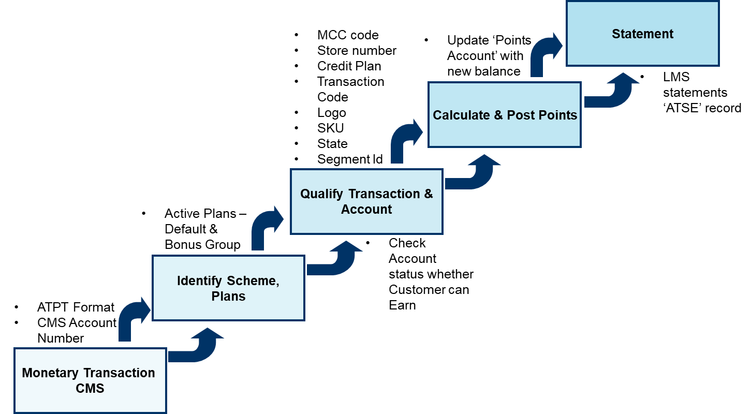
Points Calculation

Slide 16
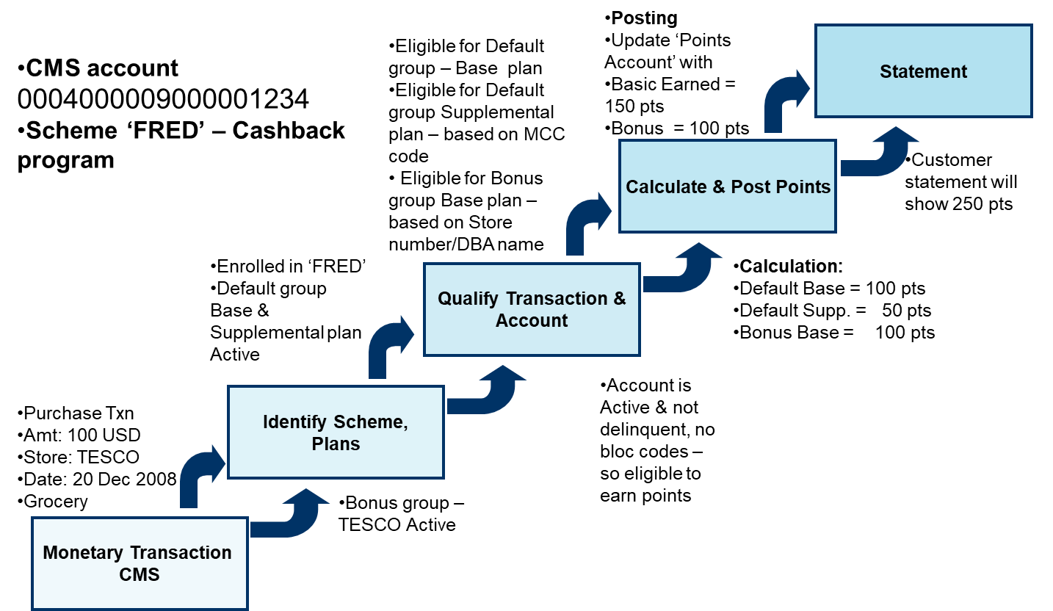
Example – Enrollment & Points Calculation

Slide 17
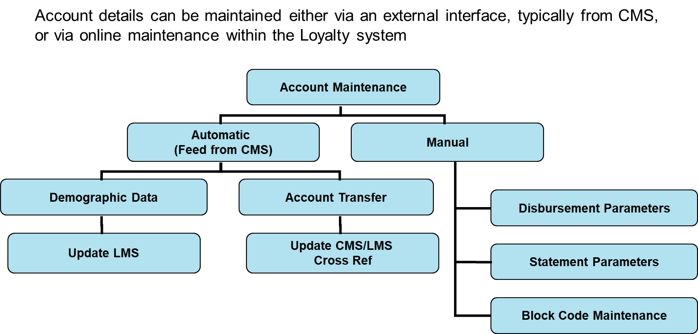
Account Maintenance

Slide 18
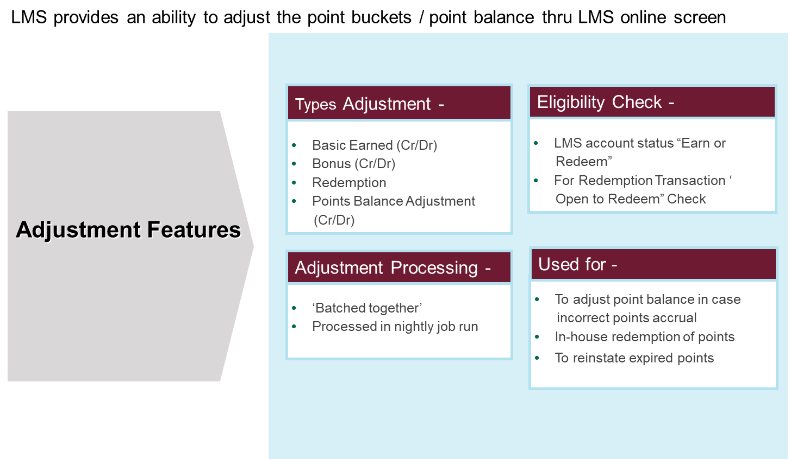
Points Adjustments
Screen

Slide 19
Redemption
Redemption is the ability to allow a customer to redeem points. The points are redeemed in exchange for products or services
Oldest points will be redeemed first
LMS account status is checked before approval is given for redemption
It can accepts incoming redemption file from a 3rd party Redemption system
For 3rd Party Redemption System, there is standard Record layout.
Online Redemption thru LMS can be done using Points Adjustment Function.
Auto Disbursement Frequency can be set to determine the time of disbursement – LMS Anniversary, Daily, Monthly, Quarterly, Specific Month
An AUTO DISBURSEMENT METHOD parameter will allow the operator to specify the method of disbursement - Check, Credit or Certificate (Voucher), Reload - External Prepaid/ Internal (CMS) prepaid

Slide 20
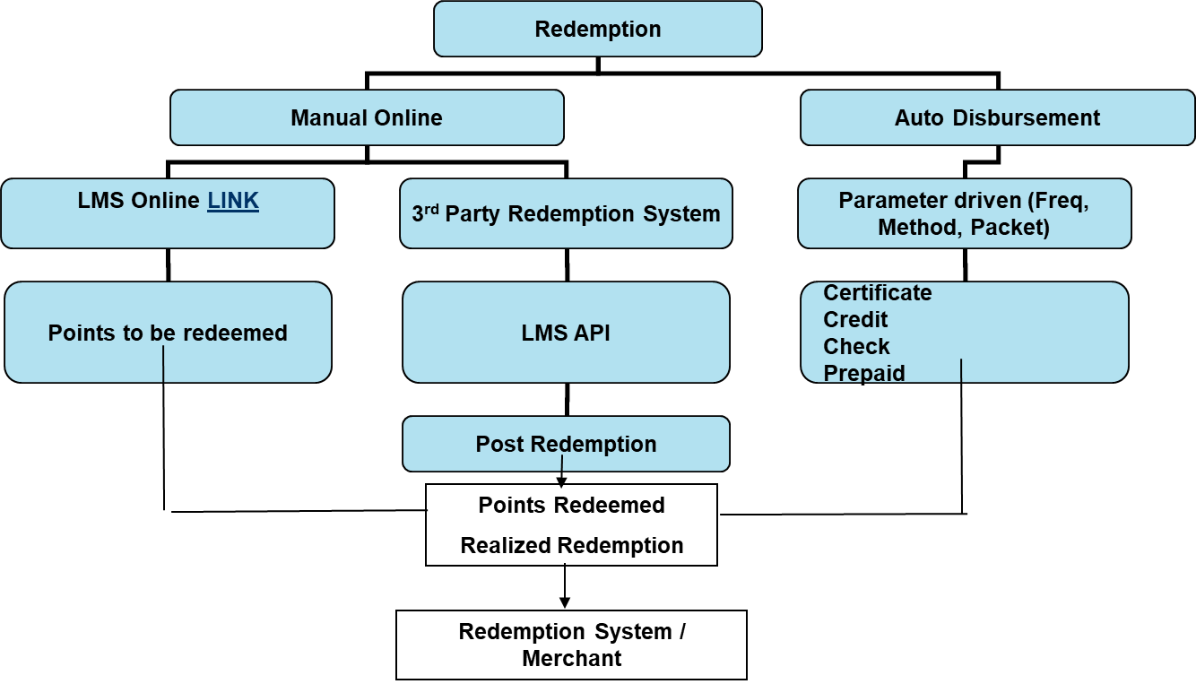
Redemption Process

Slide 21
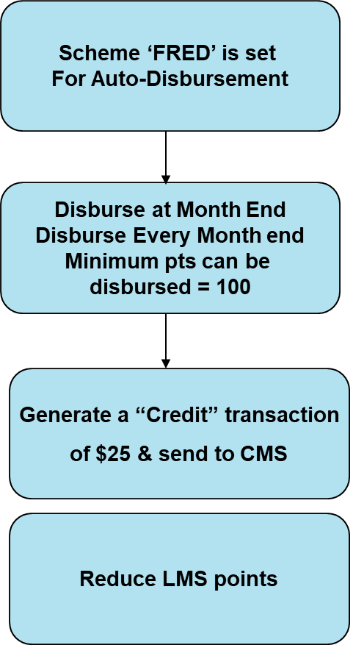
Redemption Example
Screen

Slide 22
General Ledger
For each points transaction processed, a monetary equivalent is calculated and then posted to the General Ledger.
LMS allows to define :
General Ledger account numbers for debit and credit accounts for every monetary value processed by the system.
a percentage rate for the monetary equivalent value of a point and tax rates applicable.
Two sets of General Ledger entries are produced during LMS processing:
Provisioning :
Provisioning GL relates to the scheme owner putting money aside to cover the cost of points.
Merchant Settlement :
Merchant Settlement GL relates to requesting money from participating merchants for points awarded for customer transactions originated through the merchant.

Slide 23
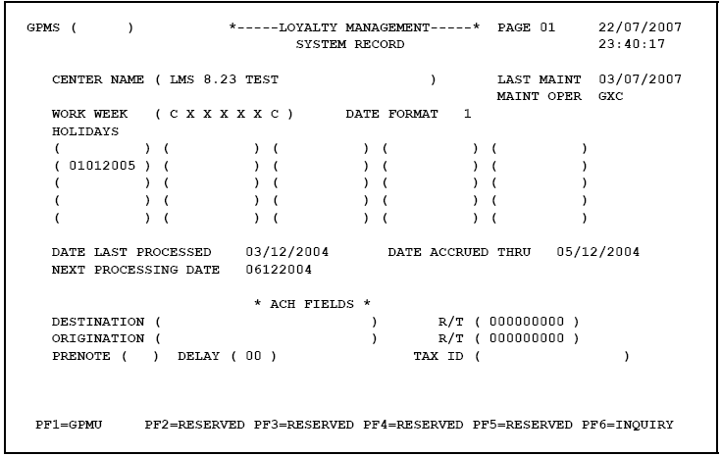
LMS Control Record – System
Back

Slide 24
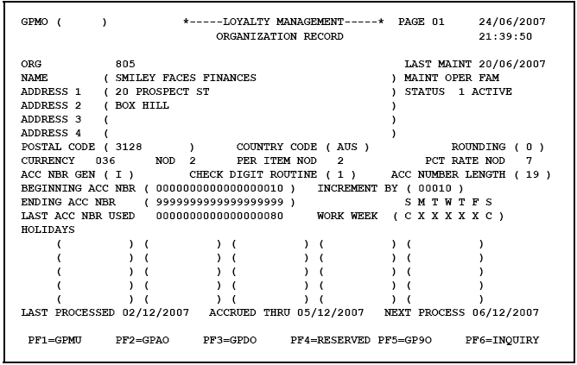
LMS Control Record – Organization
Back

Slide 25
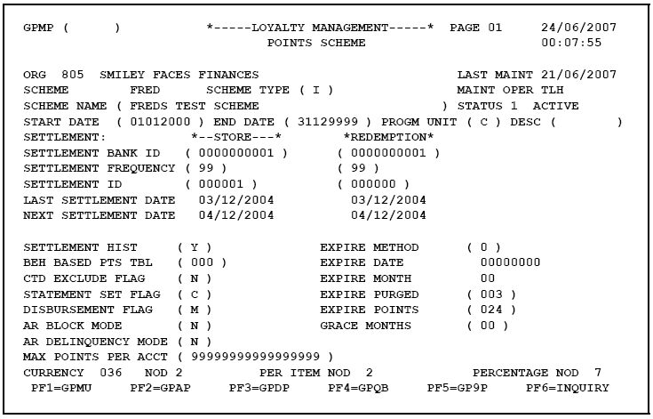
LMS Control Record – Scheme
Next

Slide 26
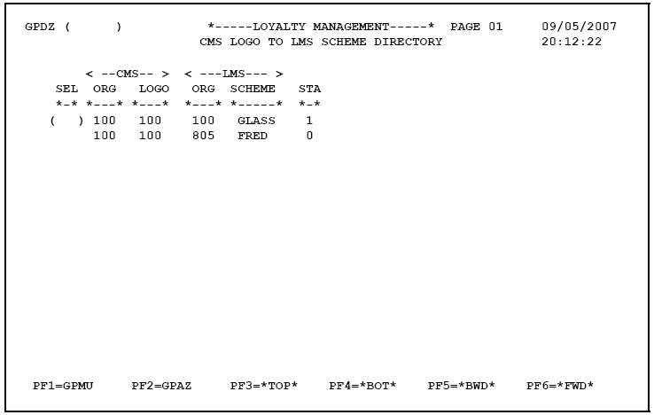
LMS Control Record – Logo to Scheme Mapping
Back

Slide 27
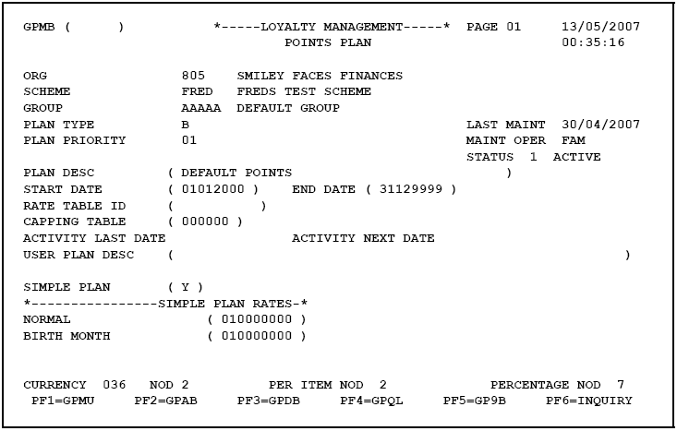
LMS Control Record – Plan
Next

Slide 28
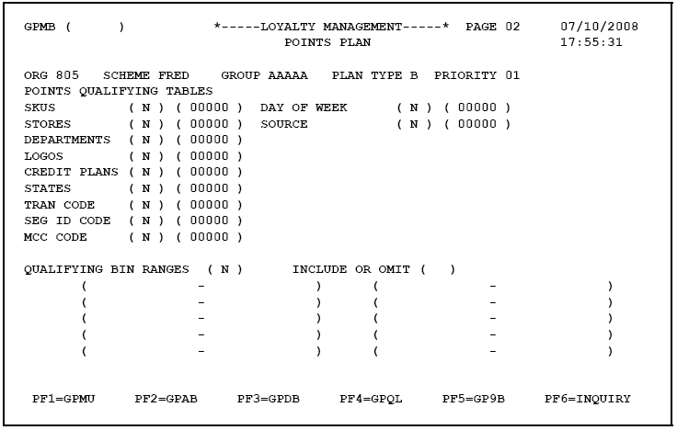
LMS Control Record – Plan
Back

Slide 29
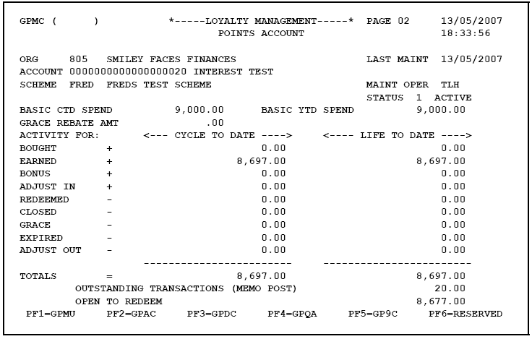
LMS Points Account
150.00
150.00
100.00
100.00
250.00
250.00
250.00
Next

Slide 30
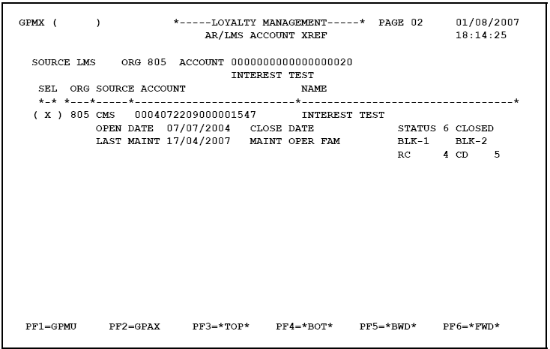
LMS-CMS Account Cross Reference
Back

Slide 31
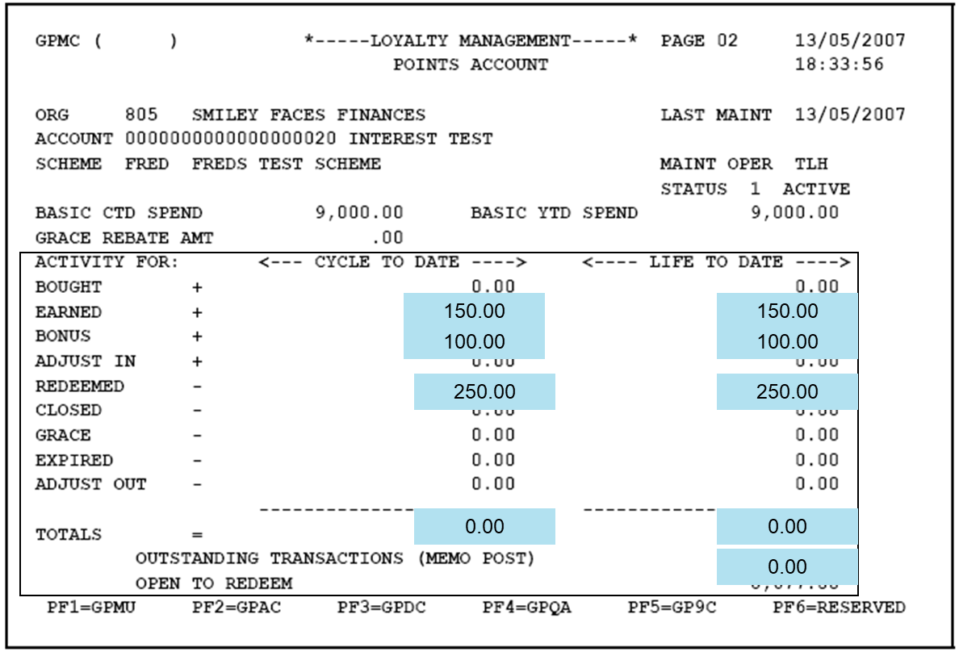
LMS Points Account – After Redemption
Back

Slide 32
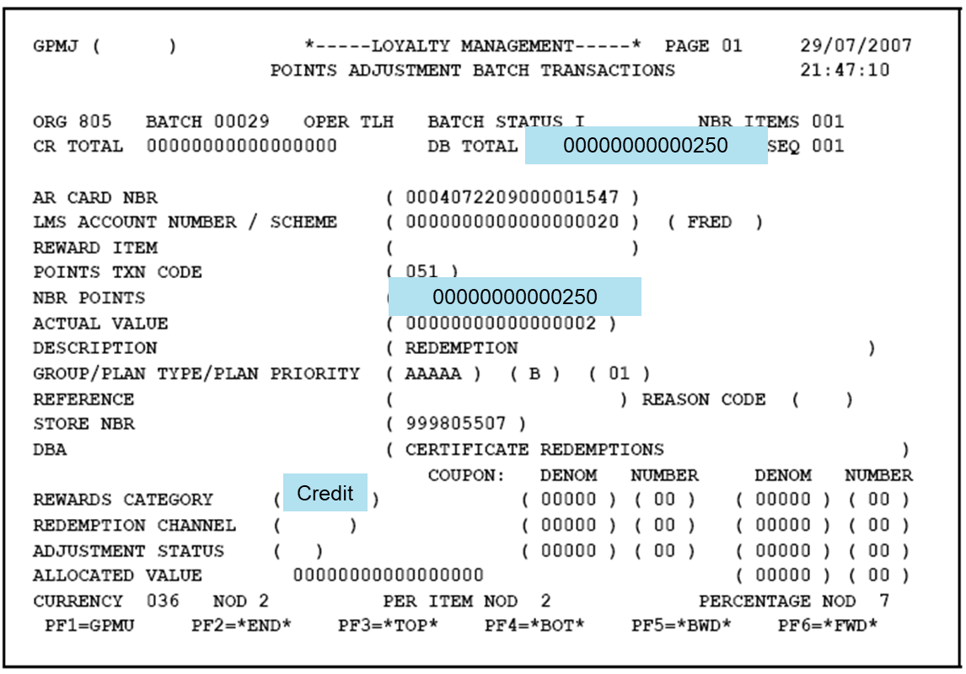
LMS Points Adjustment – Manual Redemption
Back

